Slide 1

1
ECTE250
ENGINEERING
DESIGN
AND
MANAGEMENT
2
Winter 2025 / Spring 2025
Presentation (Deliverable 1 and
7)

Slide 2
Presentations

Slide 3


Technical Talks
Do Work
or
Research
write
Report /
Paper
present
Talk
3

Slide 4
Technical
Talks,
Better View
Do Work
Report /
Paper
Tell
a story
Different
versions
Re-tell same
story
Talk
4

Slide 5
Same Story,
Different Retelling
◻ Report/Paper
◉ Details
◉ Equations
◉ Proof
◉ Algorithms
◉ Experiments
◉ Tests
◉ Charts
◉ Figures
◉ Tables
◻
Talk
◉ Is not a compressed report
or paper
◉ Main ideas
◉ Motivation
◉ Summary
◉ Summary
of
of
Methodology
Results
5

Slide 6
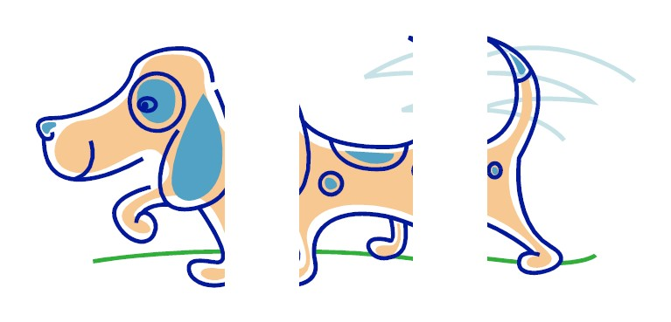
Contents
◻ Story
◻ Main ideas/aspects
of your work
◉ Details depend on type and duration of talk
■ Limit the use of mathematical formulas
■ Avoid abbreviations unless commonly known
◉ Enough details for the people to understand
the story
6

Slide 7
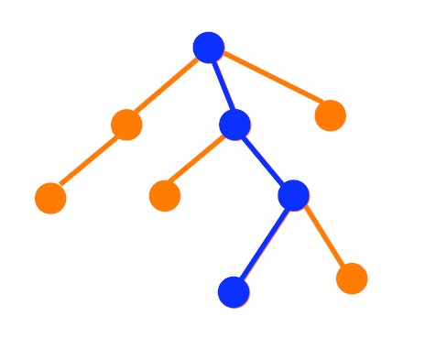
Contents
◻ Brief but complete
◉ Choose path from
root
to
leaf
◉ Omit
branches
7

Slide 8

Outline
◻ Introduction
◻ Problem Statement
◻ Method
◻ Experiments
◻ Results
◻ Conclusion
8

Slide 9
Meta-contents
◻ Outline is meta-content,
◉ a road map to navigate the
talk
◻ Unnecessary if talk is short
◉ Just start with the problem statement
◻ If used, simply let audience read
◉ Don’t insult audience
◻ If used, repeat it at
appropriate places (as a roadmap)
9

Slide 10
Contents
◻ Motivation
◉ Why did you
◉ Why did you
engage in this research?
make certain choices?
◻ Surprises
◉ Any
surprising
outcome?
Why,
or
why
not?
10

Slide 11
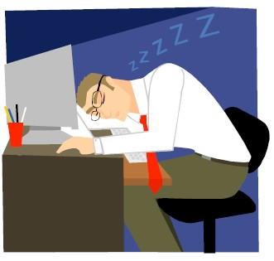
Audience
◻ Human psychology
◻ Put humans in a dimly
lit, cosy
room, with a constant
background drone
noise)
(continuous
and
monotonous
◉ What
happens?
11

Slide 12
Human Psychology
◻ Limited short-term memory
◉ Remembers 7 ± 2 things
◻ Short attention span
◉ “Tunes out” quickly if nothing
interesting
◻ Visual-Aural receptiveness
◉ Responds to Visual + Aural stimuli
◉ Responds to eye contact
12

Slide 13

ways to put audience
to
sleep
◻ Speak inaudibly: mumble
◻ Maintain monotonous voice
◻ Fill slides with lots of equations
and
text
◻ Avoid eye contact
◉ look at floor or ceiling
◻ Hide behind rostrum
◉ Do not move until talk is
over
13

Slide 14

ways to engage audience
◻ Speak clearly
◉ project voice, pronounce words
◉ vary pitch and pace of voice
◻ Avoid visual overload
◉ Minimize symbols, use icons/images
◻ Look at audience: left, back of room,
right
◻ Move around, gesture, smile!
◉ But not too much!
14

Slide 15
Repetition
◻ Tell
them
what
you’re
going
to
tell
them
◻ Tell
them
◻ Tell
them
what
you
told
them
15

Slide 16
Handling Q & A
◻ No questions?
◉ Usually means boring/unclear talk
◻ Listen to question carefully, make sure
◉ Repeat/rephrase question
you understand,
then
answer
it
◻ Defend your position, but don’t be defensive!
◉ Okay to admit ignorance, failure
◉ Suggest improvements, extensions, future work
◻ Watch the clock!
◉ Don’t let difficult questions derail your talk
16

Slide 17
Medium
◻ Report/Paper
◉ Offline
◉ Passive
◉ No speaker/sound
◻
Talk
◉ Real-time
◉ Interactive
◉ Speaker/guide
◉ Linear presentation
■ Limited X-ref.
◉ Cross-reference
possible
◉ Is
paper…
◉ Technological
aids
17

Slide 18
Fonts
◻ Arial, Verdana, Calibri, Tw Cen
◻ Arial, Verdana, Calibri, Tw Cen MT
◻ Arial, Verdana, Calibri, Tw Cen MT
MT
◻ Times New Roman
◻ Times New Roman
◻ Times New Roman
18

Slide 19

Colors
◻ Dark background, white words, OR
◻ White background,
black
words
◻ Avoid
showy
colors
19

Slide 20
Colors
◻ Dark background, white words, OR
◻ White background,
black
words
◻ Avoid
showy
colors
20

Slide 21
Animation + Video
◻ We rendered each face under
and pose.
varying illumination
◻ Illumination: single light source placed from left to
right at increments of 20°, and from top to bottom
at increments of 20 °
◻ Pose: camera placed from left to right at increments
of 20°
20°
,
and
from
bottom
to
top
at
increments
of
21

Slide 22



Animation
+
Video
22

Slide 23
Summary
◻ Technical Talk
≠
Compress(paper or report)
◻ Pay
attention
to
Content,
Audience,
Medium
23

Slide 24
ECTE250 Presentations
◻ You must present at all ECTE250 presentations deliverables (no exceptions)
◻ There are presentations for deliverables 1 and 7 on Winter-W3 and Spring-W9 respectively (all team members must present in Winter week 3 and Spring week 9)
◻ In the first presentation its about your project proposal(s)
◉ You should have two designs
◉ If you do this your team can also have a favourite and can tell
which project is your teams favourite
◻ Your team will need to produce power point slides or visual
matter for your presentation
24

Slide 25
Presentations
◻ Its natural to be nervous about your
presentation
◻ The best presentations are given
familiar with their topics
◉ But we are not born that way!
by
those
who
are
very
◉ So practice makes perfect
◉ And you can use notes if this helps
(but do not read!)
◉ Also can use humour BUT be very careful if planning to do
this (particularly useful for longer presentations).
25

Slide 26
ECTE250 Presentations
◻ Present project
proposals in few
minutes
◻ This means you
proposal
can’t spend long
on
any one project
◻ When designing your presentation,
contrast, and visual appeal (test on
don’t forget
a projector, LCD
screen contrast is often much higher)
◉ Always test the presentation room and settings beforehand.
◉ Use your own laptop (recommended) or the classroom PC
26

Slide 27
ECTE250 Presentations
◻ Fonts should be not to big not too small
◻ Use colors to highlight concepts
◻ Do not use pictures as background
◻ Illustrate and animate (plot, graphs,
images) rather than include text
tables,
charts,
◉ Note that Power Point prepared for Lecture fulfil a different
purpose! Do not take these as an example.
27

Slide 28
ECTE250 Presentations
◻ When designing your presentation to the venture capitalists
decide what your audience knows and does not know
◻ Don’t need to describe basic circuit theory as they are all
electrical engineers (use Block Diagrams!)
◻ Concentrate on product functionality instead (within the time
limits) and what it will achieve for the market relative to the
stated theme.
◻ It is OK to remind them which theme/project this product fits
into (especially in the final presentation).
28

Slide 29
ECTE250 Presentations
◻ However, for assessment purposes, it’s
show that YOU know the topic
important to
◻ So even if you think something is known briefly define:
◉ Key terms
◉ Procedures (if relevant!)
◉ concepts should be briefly explained – even if you think the marker is familiar with them – so that they (as venture capitalists) can see you understand them
■ Note: If you don’t understand them, don’t use those terms – it will be obvious and will result in questions (embarrassing??) and probable loss of marks for the team and individuals
29

Slide 30
ECTE250 Presentations
◻ Structure your presentation logically
◻ Should have an introductory slide and
slide
a concluding
◻ Cover the main aspects of your project(s),
detail to the detailed report (deliverable question time.
leave the
2) and
30

Slide 31
ECTE250 Presentations
◻ Use notes to guide your talk (but do not read),
better to memorize by rehearsing/practicing.
◻ At the same time try and get eye contact while
presenting with the venture capitalists who are target audience
your
your
◻ If possible slow down and remove pauses such
‘umms’ when thinking about what's next.
as
31

Slide 32
ECTE250 Presentations
◻ Practice, Practice, Practice
◉ Practise out loud, either to friends or
of the mirror
◉ If using notes, practice with notes but
family or in front
try also to have
eye contact with the mirror as often as possible
◉ Also your notes should actually be points rather than a
written speech
◉ Best is to remember what you want to say and when you want to say it (could animate and automate your timing if its practiced enough)
32

Slide 33
ECTE250 Presentations
◻ Use introductory phrases for new
words to connect your ideas
points,
and
linking
◻ Practise the volume of your speech
◻ Practise the speed at which you talk!
◻ Don’t say more than you have allocated
time
to spend
(so this means only say the important points – don’t
get diverted by trivia or too much detail!)
33

Slide 34
ECTE250 Presentations
◻
Your voice should be natural, expressive and easily heard (not
monotone and boring)
◻
Use effective body language – posture, gestures, eye contact.
Appear confident
◻
If you can (given the limited time for the presentation) try and keep your audience interested by asking questions and directing their attention to interesting points on your slides.
◻
In question time anyone can ask questions (with venture capitalists given priority), hence expect your audience to ask questions, and try to predict and prepare for these questions (if possible, you can prepare some backup slide).
34

Slide 35
ECTE250 Presentations
◻ Your team could have a uniform
◻ Or dress consistently
◻ Some say you should dress professionally
◻ Be well dressed and groomed so it looks like
to sell your idea(s)
you want
◻ Don’t have to be too formal but it does look more
professional if you are!
35

Slide 36
Deliverable 1
◻ Guidelines (on Moodle)
◻ Marking
Criteria
(on
Moodle)
36

Slide 37
ECTE250 Presentations
◻ RMIT has some good material on oral
worth looking at:
presentations
http://emedia.rmit.edu.au/learninglab/content/oral-
presentations
37

Slide 38
Acknowledgement
◻ David Hsu, NUS; Peter Vial, UOW; Stefano Fasciani, Oslo University; Abigail Copiaco, University of Dubai; Kiyan Afsari
38

